Slide 1


University Life: Making the Most of Lectures
Brought to you by:
Your Peer Mentoring Team

Slide 2
Objectives
After today’s session, you should be able to:
Describe good practice for attending a lecture
Prepare yourself for making the most of your lectures each week
Utilise a note-taking strategy to revise the content of your lectures

Slide 3
What is a lecture?
Notes:
It’s important to gauge the preconceptions of lectures before launching into the workshop. This discussion should last approximately 5-10 minutes, depending on how willing the students are to volunteer their thoughts.
Students may or may not already know what the lecture format is – or they may not. They may have already formed opinions (“It’s boring”, “It’s not a good way to learn”) or they may still be excited about the “grown up” way of learning. The answers given to What is a lecture? should be discussed, none should be ‘rubbished’ or dismissed out of hand, and if possible, quotes/short summaries of each learner’s thoughts should be recorded (e.g. on a whiteboard) and then revisited at the end of the session.
If students are shy, or unwilling to offer their suggestions, the mentor team (or, if solo, yourself) can offer your preconceptions from before you started your course as a starting point. Be honest, especially if your preconceptions turned out to be wrong, as this may help to tease information out of the participants.
If, generally, students have a positive attitude towards lectures, then this is great – build on this focus by helping them to understand how to make the most of the lecture setting.
If, generally, students have a negative attitude towards lectures, then this is also great – this is your opportunity to reassure the students that the lectures are a useful use of their time, to explain how to best make use of the lectures, and to maybe relate some of your own personal positive lecture experiences. Please do not discuss any negative lecturing experiences.

Slide 4
What if I have a question?
Ask! Different lecturers have different ways of dealing with this (some like you to ask throughout, some like to do questions at the end), but never be shy of asking questions.
In the worst case scenario, speak to your lecturer outside of the lecture – in their office hours, for example.
Can lectures be interactive?
Absolutely! You might be asked questions, to work in small groups…
It’s been proven that this helps you to learn!
lecture
/ˈlɛktʃə/
noun
1. a discourse on a particular subject given or read to an audience
2. the text of such a discourse
3. a method of teaching by formal discourse
4. a lengthy reprimand or scolding
verb
5. to give or read a lecture (to an audience or class)
6. (transitive) to reprimand at length
Word Origin
C14: from Medieval Latin lectūra reading, from legere to read
Collins English Dictionary - Complete & Unabridged 2012 Digital Edition © William Collins Sons & Co. Ltd. 1979, 1986 © HarperCollins Publishers 1998, 2000, 2003, 2005, 2006, 2007, 2009, 2012
What should I do if I miss a lecture?!
Try not to panic! The most important thing is to make sure you have access to the lecture notes.
You then want to make sure you have the information from the lecture itself – if you have a good friend you know that went to the lecture, maybe they will help you with your notes?
What’s a Seminar or Tutorial?
Seminars are usually smaller than lectures, and often require you to prepare in advance usually for a discussion or review of questions.
Notes:
The dictionary definition is a bit dry, but is a useful way of confirming what the learners thought earlier. If they were wildly off with what they thought a lecture was, re-align their beliefs at this point.
The four questions here are ‘Frequently Asked’ – please feel free to bring in your own (positive) experiences and stories to supplement these. The workshop does not really focus on seminars, but they are mentioned briefly here; If your subject area is heavily seminar focused, you may want to spend more time talking about what a seminar is/how to make good use of a seminar at this point.
Of particular importance: Share the notion that lectures can be interactive, and that this helps them to be fun, and that it helps the learning. If you can think of a specific fun activity you have done, don’t spoil it for the upcoming students, but maybe give them a hint that they have something they can really look forward to.
While talking about questions, emphasise that there is no such thing as a stupid question. If you are thinking/questioning something, there is a very, very good chance that someone else in the room is too.

Slide 5
What should I do in a lecture?
Should I do anything to prepare?
Yes! Your lecture notes will be available in advance of the lecture as part of the universities ERAC plan. However these notes may often be a summary of important points or additional papers to read.
Download/get a copy, read them through, and be prepared
Bringing a copy of the notes to the lecture can help you to take notes
Can I record my lectures?
Tricky one! This is down to the member of staff. You should always ask, and if given permission, make sure to do so without causing disruption
What if I’m late?!
Don’t panic! Enter the room as quietly as possible to cause as little disruption as possible. Quickly and quietly locate the nearest, most convenient seat.
Notes:
At this point you might want to advise about lectures notes being on Moodle. Use your subject-specific, insider information here – if you know there are certain units that have really good gapped notes on Moodle, and bringing printed copies to the lecture would be beneficial, let the students know!
Regarding being late – general advice is to avoid being late wherever possible, but, most staff would prefer a student to turn up late (quietly) than to not turn up at all. You might have some specific advice (e.g. using the back doors in C0.14) here that could be helpful!

Slide 6
What should I do in a lecture?
Can I use my phone in a lecture?
This one is usually a no. No checking your messages, surfing the internet for fun – However, some lecturers may allow the use of phones for things like looking up key words or taking part in a quiz. This will be clearly flagged.
What about a laptop or tablet?
Check first if you would like to use one for taking notes, accessing Moodle or any academic purpose.
How do I take really good notes?
I’m glad you asked…
Notes:
This slide is reasonably self-explanatory. Please emphasise that using your phones in lectures is not only harmful to your own lecture experience, but to others’ too. Similarly, it shows disrespect to the lecturer, and most (if not all) can tell when students are discreetly checking Facebook.
The aim is not to scare students, but if you have any particularly funny stories (not horrifying!!) of students using their phones in lectures and being reprimanded, maybe share one here.

Slide 7
Cornell Notes
Take your page and divide it into three:
The Main Section – Note Taking
Write down the main ideas of the lecture here. Avoid long sentences, and paraphrase where necessary. Use symbols and abbreviations freely!
The Left-hand Section – Key Words
Write down any and all key words, phrases and questions here.
The Bottom Section - Summary
Used for writing up a summary of your notes on this page.
You should write your summary within 24 hours of the lecture taking place!
You should reflect on and revisit your notes regularly!
Notes:
The Cornell Note Taking System is very simple, and can be very beneficial for students who are taking notes at university level.
If you are not familiar with Cornell Notes, there are lots of resources online:
http://coe.jmu.edu/learningtoolbox/cornellnotes.html
https://en.wikipedia.org/wiki/Cornell_Notes
https://www.umfk.edu/learning_center/studying_tips/notes/
https://www.lynda.com/Business-Skills-tutorials/Cornell-note-taking-system/373782/459919-4.html
The idea here is not to force the students to use Cornell Notes – it is to get them to think about the way in which they note take. Please do emphasise that this is personal, and what works for one person may not work for another, and that first year is the perfect opportunity to try out different note taking strategies and techniques to find the one that works best for them.
The Student Support Officer (contactable via the Student Hub) can also help with general study skills, such as note taking and making the best of lecture notes. This might be a good opportunity to mention this – particularly if you have met with the SSO previously.

Slide 8
Lecture Practice
This virtual lab will revolutionise science class
You have no idea where camels really come from
Cheese, dogs and a pill to kill mosquitoes and end malaria
This tiny particle could roam your body to find tumours
Notes:
Make sure you explain the following activity clearly to the workshop participants – or they will be confused, and just watching a YouTube video!!
In the following X minutes of the workshop, students will have the opportunity to practice ‘being in a lecture’ (and ideally, taking notes) by observing one of the four TED talks pointed to in this slide. Each is clickable, and will take you directly to the appropriate slide for that video. Please be aware of how long each video is, for planning purposes.
The four talks at the time of writing are:
This tiny particle could roam your body to find tumours (10 minutes 44 seconds)
This virtual lab will revolutionise science class (11 minutes 27 seconds)
You have no idea where camels really come from (12 minutes 28 seconds)
Cheese, dogs and a pill to kill mosquitoes and end malaria (10 minutes 18 seconds)
As TED Talks, they are very accessible. There is not a specific talk for a specific subject area. You could either choose a talk which you like best, or which you think works best for your discipline, or poll the workshop for which they would like to listen to. It is definitely a good idea for you to watch the talk(s) beforehand so that you can handle the debrief better. If there is one talk you are prepared for, and three you are not, lead the workshop such that that is the talk you use for the task without giving the attendees the choice.
To spice up the activity a little, there are also ‘roleplay’ cards you should distribute to the students. These cards offer the students the chance to explore student personas. Amongst them are:
The Loud Latecomer
Leave the room.
You are going to re-enter in about five minutes, being noisy and disruptive.
On arrival, apologise to your peer mentors for being late, and choose the least convenient seat to sit in possible.
The Quiet Latecomer
Leave the room.
You are going to re-enter in about five minutes, as quietly as possible.
On arrival, don’t speak to anyone, and choose the closest/most convenient seat to sit in as possible.
The Serial Socialiser
You haven’t seen your friend (sitting next to you) in at least two hours. You have so much you want to say to them.
During the lecture, strike up casual conversation in a hushed whisper with your next door neighbour – even if they’re not willing to talk back!
Somewhere Better to Be
In about eight minutes, when you think the lecture is nearing the end, start packing your things away.
Shortly after, get up, and leave the room.
Don’t come back in, until your peer mentors ask you to.
The Device Addict
You love your device, be it smart phone, tablet or laptop.
Throughout the lecture, use your device constantly – check Facebook, Twitter, text messages, WhatsApp, anything.
A Forgetful Student
You want to make the most of the lecture, but you have forgotten to be prepared. You don’t have a pen, or anything to take notes in.
Try to borrow a pen, and paper, from your neighbours after the lecture has started.
A Student
You want to make the most of the lecture, and so you have brought along a pen, something to write in, and you are ready to take notes.
Ensure the roleplay cards are pre-printed, and hand them out (secretly and randomly) to all attendees before starting the activity. Tell them to keep their personas secret until after the lecture has concluded. Remember that some students will need a few minutes to exit the room, as they are going to be ‘latecomers’. You will need to control the number of attendees who are not ‘A Student’ based on the number in attendance on the day – try to maintain a good balance so that the session does not descend into complete chaos!

Slide 9

This tiny particle could roam your body to find tumours
Sangeeta Bhatia
Finished?
Notes:
In an emergency, the URL is: https://www.youtube.com/watch?v=_bphPa7Wp4c

Slide 10
This virtual lab will revolutionise science class
Michael Bodekaer
Finished?
Notes:
In an emergency, the URL is: https://www.youtube.com/watch?v=iF5-aDJOr6U

Slide 11
You have no idea where camels really come from
Latif Nasser
Finished?
Notes:
In an emergency, the URL is: https://www.youtube.com/watch?v=c9V6OKlY80k

Slide 12
Cheese, dogs and a pill to kill mosquitoes and end malaria
Bart Knols
Finished?
Notes:
In an emergency, the URL is: https://www.youtube.com/watch?v=iVcJmZcxlIY

Slide 13
How was it?
Notes:
This is the activity debrief.
You should ask the learners how they found watching the lecture. Try not to focus on the specific roleplay roles at this point, try to focus more on the actual lecture itself, and the note taking.
If you have prepared, you might want to ask some questions, or spark some discussion, about the lecture that has just been played. You might want to ask the students to share their notes, or have a short discussion, or if they have any strong opinions about what they have just seen. The point here is to get students to appreciate what they can get out of a lecture (despite interruptions)
The next slide is for teasing out the role play profiles (if learners want to discuss this sooner, rather than later, you could skip ahead).

Slide 14
Confessions – Who had what role?
How did your role affect you?
How did having your role make you feel?
How did you feel about the other roles?
The Forgetful Student
The Loud Latecomer
The Serial Socialiser
The Quiet Latecomer
Somewhere Better to Be
The Device Addict
Notes:
As you discuss each role profile in turn, ask the students who had those cards to confess. Ask them – as a group – how they felt.
Hopefully, many of the students will confess to feeling guilty or ashamed that they were ruining the experience for the other students. Please don’t try to guilt-trip or shame spiral the students! Remember, they were doing what you told them! But do try to get them to realise that the activities on these cards can be very harmful to the lecture experience.
A useful question to ask might be ‘How would you deal with this problem in a real lecture’?

Slide 15
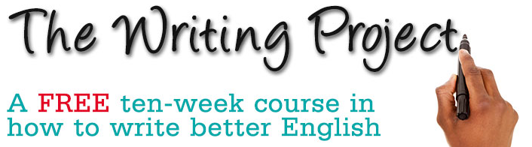
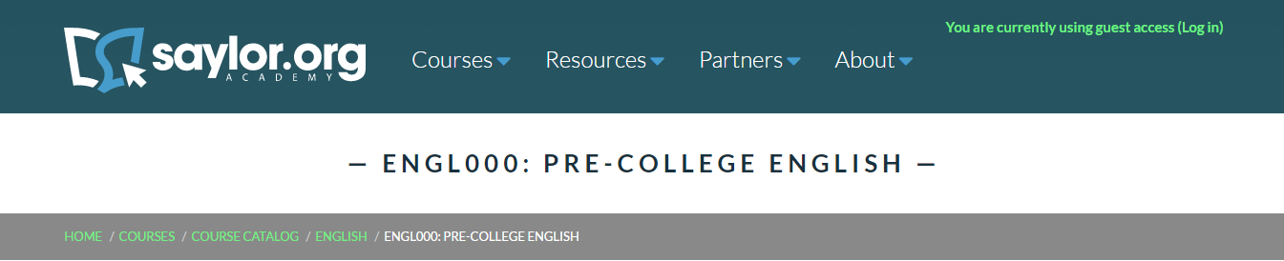
Useful courses:
Attending MMUs “The Writing Project” can improve both your writing and note taking skills
http://www.writingproject.mmu.ac.uk/
Saylor.org also offer a really good course called Pre-College English. This course provides useful resources and covers:
Note taking
Reading
Writing
Both of these are completely free!
Notes:
A link to pre college English: https://learn.saylor.org/course/view.php?id=42
Mention additional useful courses? – Saylor offer more advanced courses as well
Include about Dartmouth uni resources? Maybe even have print outs?
Note taking- http://www.dartmouth.edu/~acskills/success/notes.html
Reading- http://www.dartmouth.edu/~acskills/success/reading.html

Slide 16
Additional Advice:
Choose a comfortable position in the lecture. Sitting too far forwards or backward can cause you to strain, thus causing tiredness.
Using different coloured pens or post-it notes can be a very good way of organising your thoughts during your lecture.
Make sure to mark all your notes with a title and date. It may also be useful to include the unit title on your notes.
Make rough notes in lectures and then write them into a note book or file when you get home. This helps you absorb the information from the lecture and makes revising a lot easier!
Everyone has a different style of note taking, try to spend some time working out what works best for you. Watching YouTube videos and making notes is a good way to determine if your technique is lecture ready.
Notes:
Coloured pens help to define the important information and also help students remember information.
Title and date on notes help to keep students organised and can assist in assignments and revision. As it makes locating information a lot easier.
Good places for note taking ideas or tips are YouTube and Tumblr

Slide 17
Summary
You can make the most of lectures by preparing for them
Lecturers expect a certain amount of etiquette:
Ask before using your phones
Ask before recording a lecture
Don’t talk through a lecture
Finding the right note-taking strategy for you is important
Give ‘Cornell Notes’ a try, but take note - there are others
Remember to ask questions in lectures!
Learning from lectures is a skill to be developed – don’t expect to master it right away, but keep practicing and you will get better
Notes:
As the summary suggests – students might want to ask questions! Be sure to reassure the new students that lectures aren’t scary, but give the general message that attendance is really important.

Slide 18
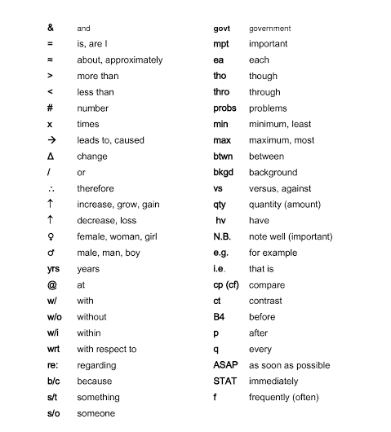
Abbreviations
Many people like to use abbreviations when taking notes in a lecture. Here are a few examples of abbreviations for note taking….
However these are not all of them.
Many people prefer to make their own abbreviations. If you are going to do this it is important to keep track of what your abbreviations mean!
Notes:
Would this slide be better as a hand out?

